Slide 1
Welcome to Year 4 Camp Meeting

Slide 2
Year 4
We have booked Delaware for 3 days
22nd-24th June
£170 - £50 deposit by 14th February to secure your child's place. Full payment by 22nd May.

Slide 3
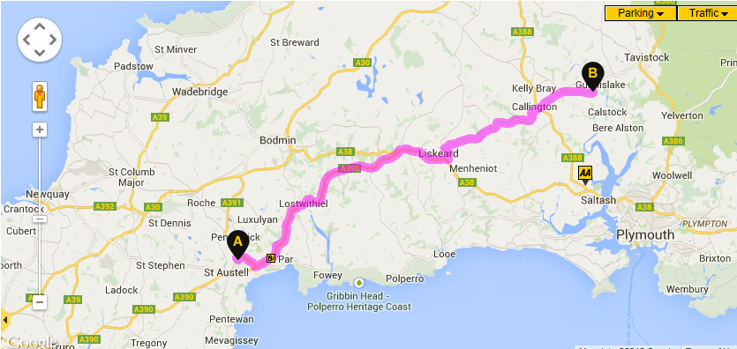

Slide 4
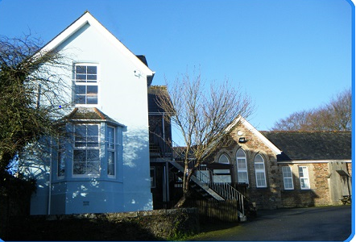
The Delaware Outdoor Education Centre near Gunnislake in the Tamar Valley provides a spacious, centrally heated, residential base, with a large sports field and a sunny garden with picnic benches.

Slide 5
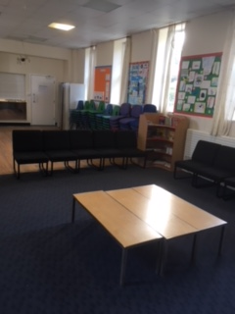
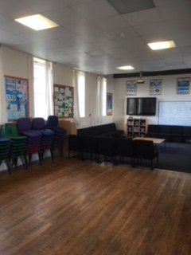
Large common room.

Slide 6
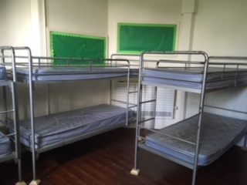
The Centre provides small dormitory accommodation, for up to 67 people.
In the main centre (The Old School) there are 5 large dormitories: four rooms sleeping 8 and one room sleeping 12, all laid out with bunk-beds. There are 3 staff rooms; two rooms sleeping 2 and 1 single room. There is a kitchen, dining room / common room, showers, toilets and drying room.

Slide 7
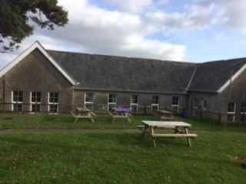
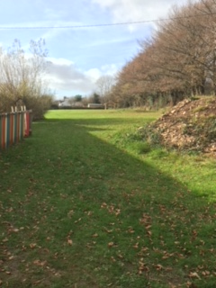
Outside space

Slide 8
Activities
Open canoeing in ‘Canadian’ canoes
Outdoor rock climbing and abseiling
Indoor climbing with indoor abseiling
Moorland exploration & navigation
Archery
Team building and problem solving
Orienteering
Mountain biking
Gorge walking
Raft building
Survival skills

Slide 9
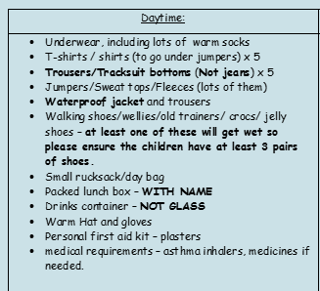
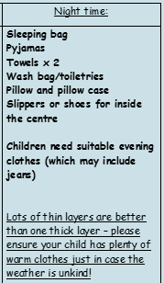
Kit list

Slide 10
Thank you for coming.
Delaware 2020
http://cornwalloutdoors.org/centres/delaware/

