Slide 1
Dear parents/ Carers
Please find a copy of the London Presentation that was used for our meeting. This is an initial plan of the days and activities that we will be taking part in. However, the order of activities and day schedules may changed depending on bookings, number of children etc. Closer to the time we will provide a confirmed schedule. The trip is open to all children and we would love to take every one, if you or child has any worries please come and speak to one of the class teachers who may be able to answer any questions or queries. The final day to pay the £100 deposit is Monday 30th September. After this date, we will not be able to take any more bookings as we will need to begin booking up attractions that fill up quickly. If you have any concerns about payments please speak to Mrs Moseley or Mr. Dingle.
Many thanks,
Jordan Dingle and Louise Pezzarini

Slide 2
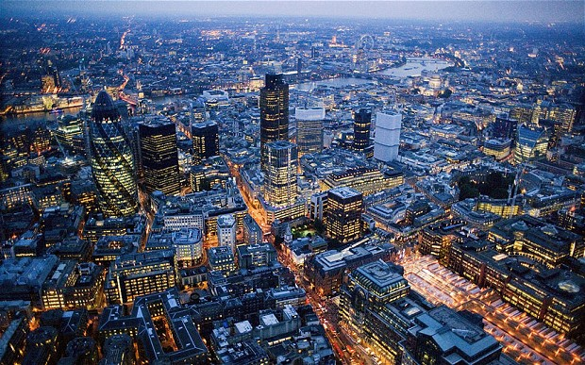
London 18th -22nd May 2020

Slide 3
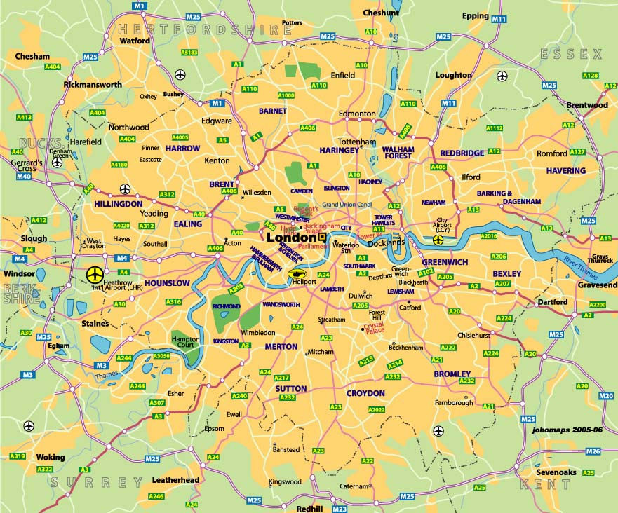

Slide 4
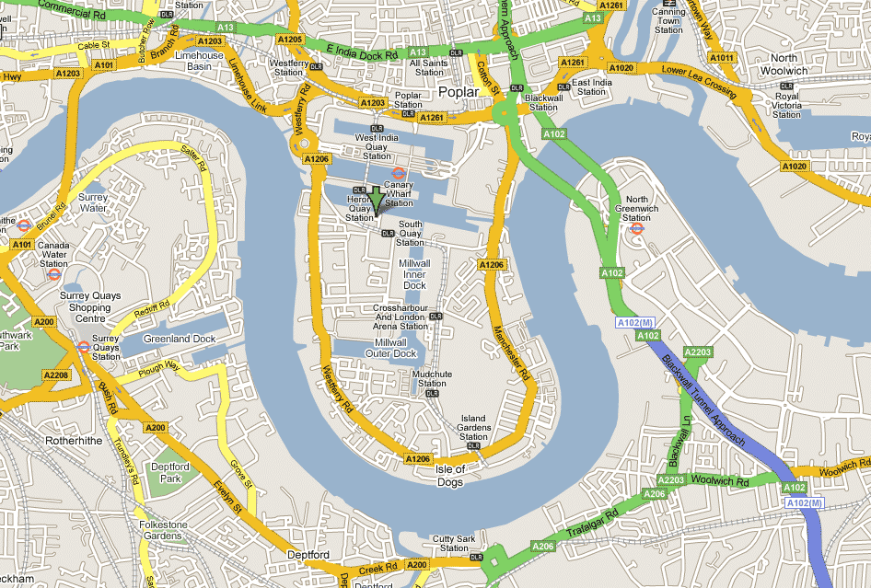
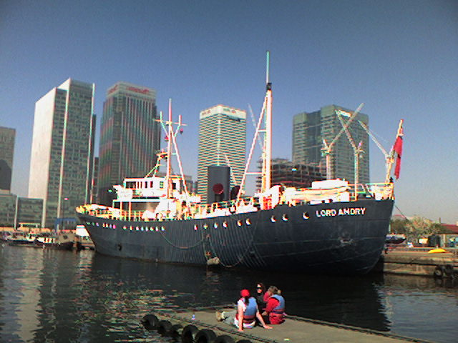

Slide 5
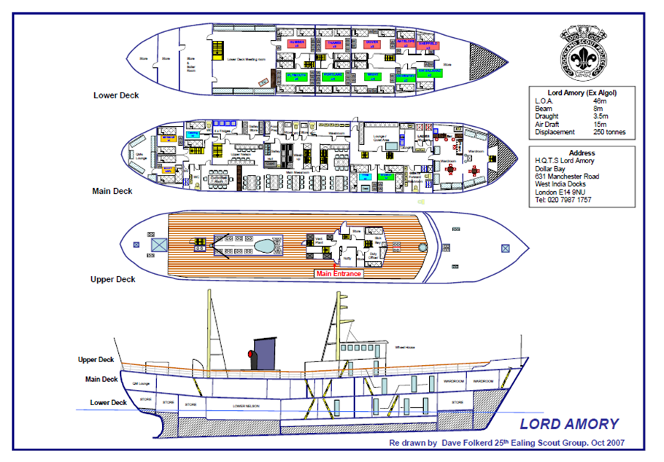
Lord Amory

Slide 6
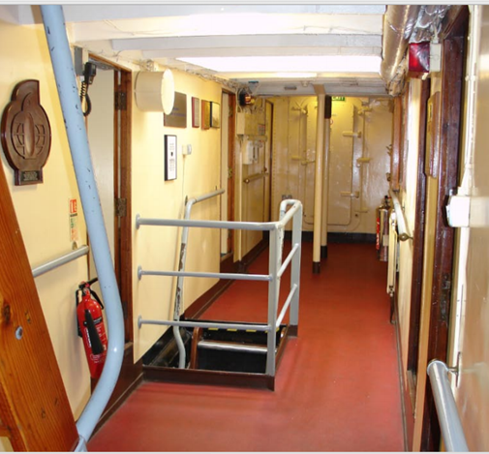
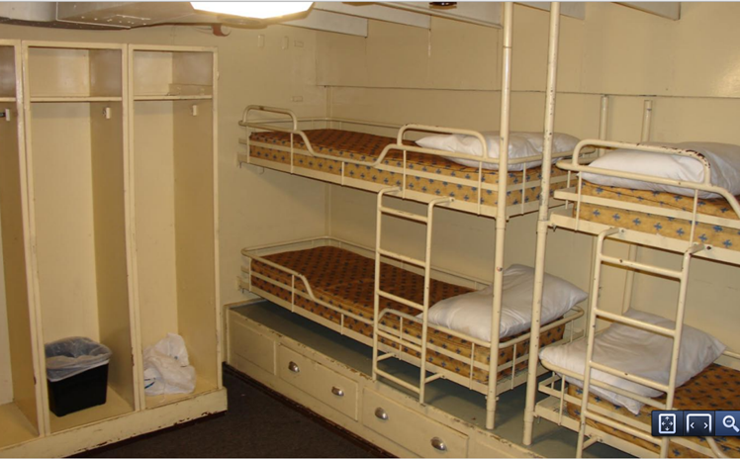
Lord Amory

Slide 7
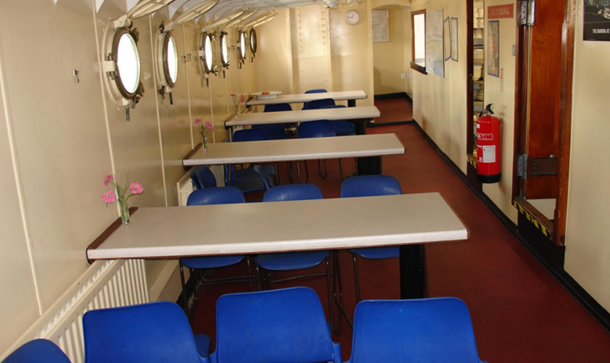
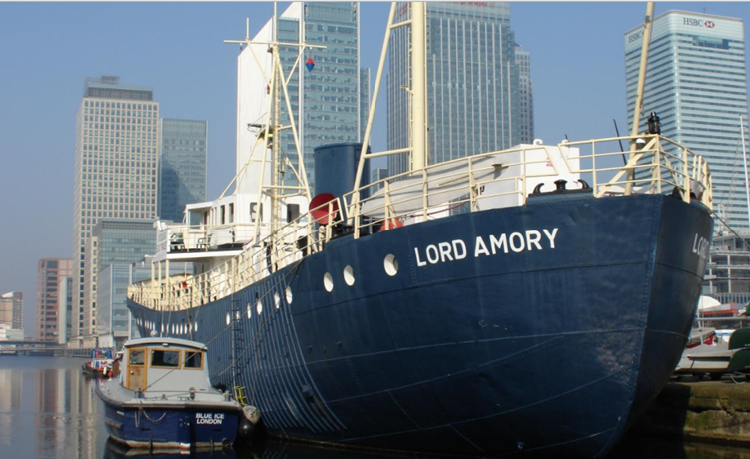
Lord Amory

Slide 8
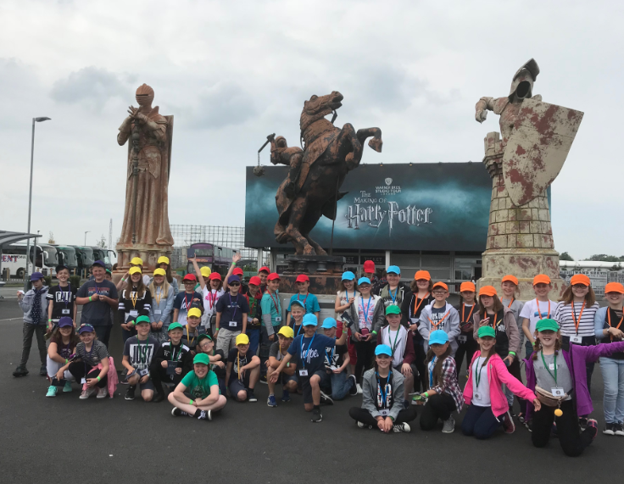
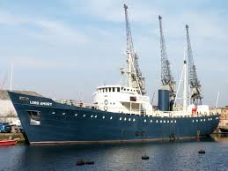
Monday
6.30am Leave Polkyth on the coach
2:00pm Arrive at Harry Potter Studios tour + workshop
7:00pm Arrive at Lord Amory –
- Dinner, unpack, explore the boat

Slide 9
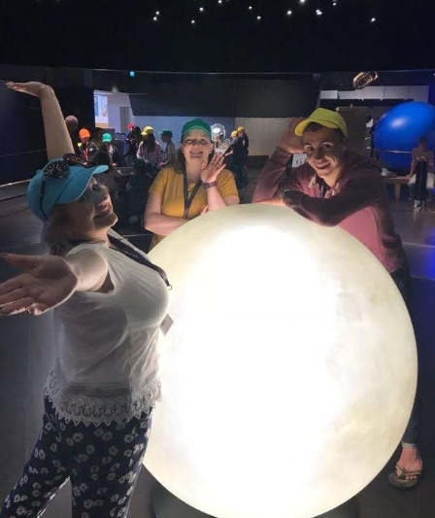
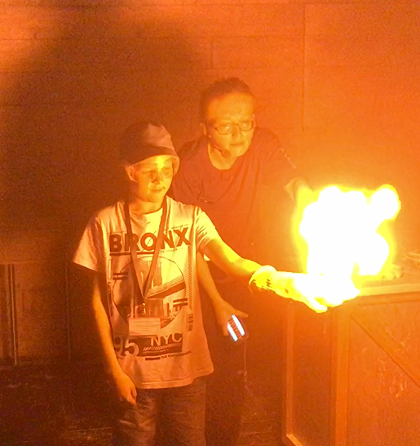
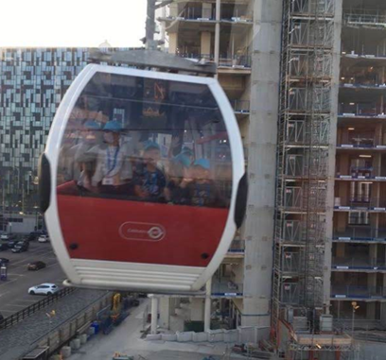
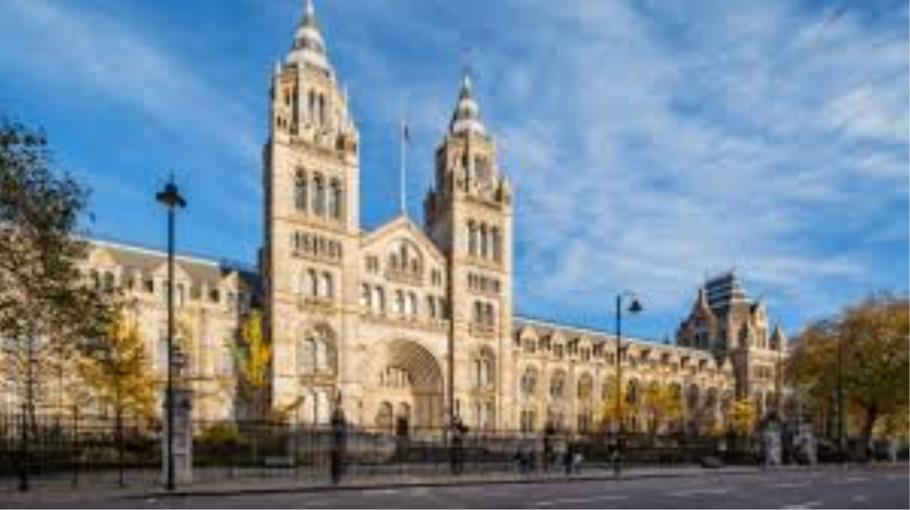
Tuesday
Tuesday 19th May 2020
10:00am Natural History Museum
2:00pm Science Museum
7:30pm Cable Car and DLR

Slide 10
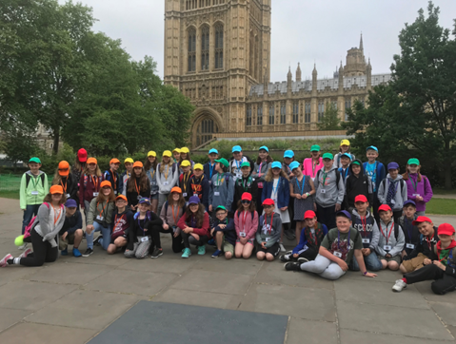
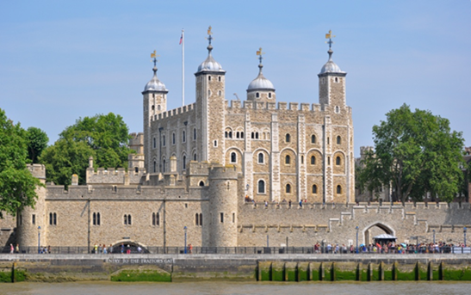

Wednesday
10:00am Tower of London Tour and Workshops
2:00pm Houses of Parliament
5:30pm Pizza Express meal out – 5:30pm

Slide 11
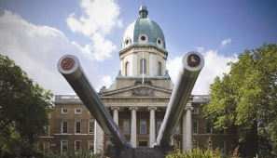
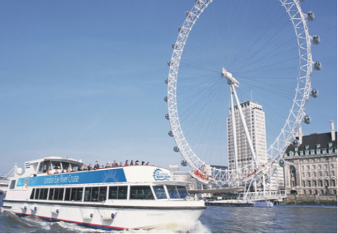
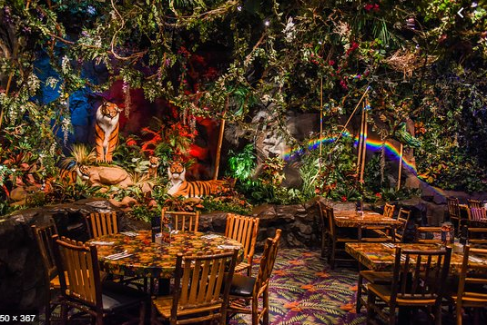

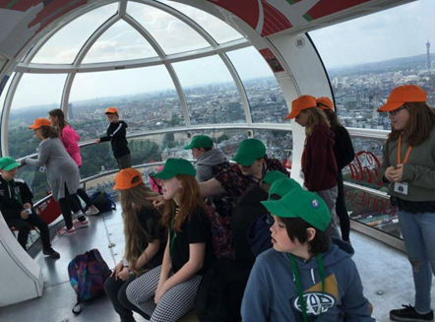


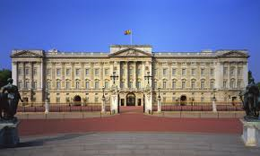
Thursday
10:00am Imperial War Museum
2:30pm London Eye + 4D experience
4:00pm Buckingham Palace
4:45pm Rainforest Café
Show 7:00pm

Slide 12
Friday
9:30am Depart Lord Amory by coach
Arrive home 6pm (approximately)

Slide 13
Other Information
Kit List – Sleeping Bags + Pillow cases required but not pillows
Electronic devices are not allowed
Recommended cameras are disposable but if it must be electronic then the child is responsible
Spending money no more than £30 and the children are responsible for this.
Food – Pasta Bolognaise, Pizza, Chicken and Chips
Medication – please pass to an adult on the morning of the trip.
Adults - We will confirm adults nearer the time but a number of current Year 6 staff have previously attended.
Contact – An adult will be updating the school Twitter and Facebook account with what we have been up to. If you need to contact us you will need to contact the school in the first instance. Out of school hours an email address will be given for emergency contact only.

Slide 14
Deadlines.
The cost for the trip will be £350. To reserve a space, you need to return the slip below and a non-refundable deposit of £100 should be made by Parent pay by Monday 30th September. In order to make it easier and spread the payments over the year, a second instalment of £50 will be due by 31 January 2020, another £100 by 13 March 2020 and the final £100 will need to be paid by Friday 8th May 2020.

Slide 15
Any Questions?

